Slide 1
Credit Card Fraud Detection - Machine Learning Approach
Presented To:
Presented By:
Mr. Abdul Muntakim
Lecturer
Dept. of CSE
Daffodil International University
Name: Muid Hasan Maruf
ID: 0242220005101237
Section: 63_A2
Dept. of CSE
Daffodil International University

Slide 2
Project Introduction
Overview: Detect fraudulent credit card transactions using machine learning.
Importance: Enhances financial security, protecting users and institutions.
Challenges: Class imbalance, data complexity, real-time detection.

Slide 3
Dataset Overview
Source: Kaggle's credit card transaction dataset.
Features: Time, Amount, and 28 anonymized features.
Total transactions: 284,807; fraud cases: 0.17%.
Class imbalance: Fraud vs. normal transactions.

Slide 4
Objectives
Train and evaluate multiple machine learning models.
Optimize accuracy and minimize false negatives.

Slide 5
Data Cleaning
Preprocessing Steps:
No missing values found.
Standardized 'Amount' feature.
Dropped irrelevant columns (e.g., 'Time').

Slide 6
Feature Engineering
Techniques:
Extracted hour from transaction time.
Selected top features using mutual information.
Features used for model training: V4, V11, Amount, etc.

Slide 7
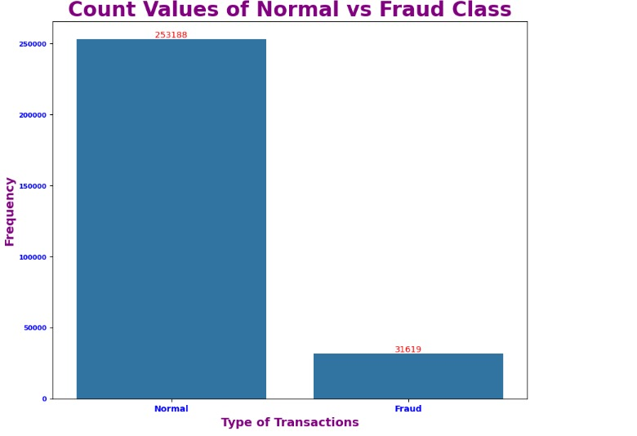
Visualizations
Class distribution: Visualize fraud and normal transactions.
Transaction amounts: Histograms for each class.
Key observations: Highlight class imbalance.

Slide 8
Machine Learning Models
Models Evaluated:
Logistic Regression
Decision Tree
KNN
Naive Bayes
Random Forest
XGBoost

Slide 9
Training Process
Split data into 70% training and 30% testing.
Used SMOTE to balance classes.

Slide 10
Performance Comparison
Highest accuracy achieved by XGBoost (94.33%).
Accuracy for Logistic Regression: 88.96%
Accuracy for Decision Tree: 92.02%
Accuracy for K-Nearest Neighbors: 92.14%
Accuracy for Naive Bayes: 85.02%
Accuracy for Random Forest: 94.22%

Slide 11
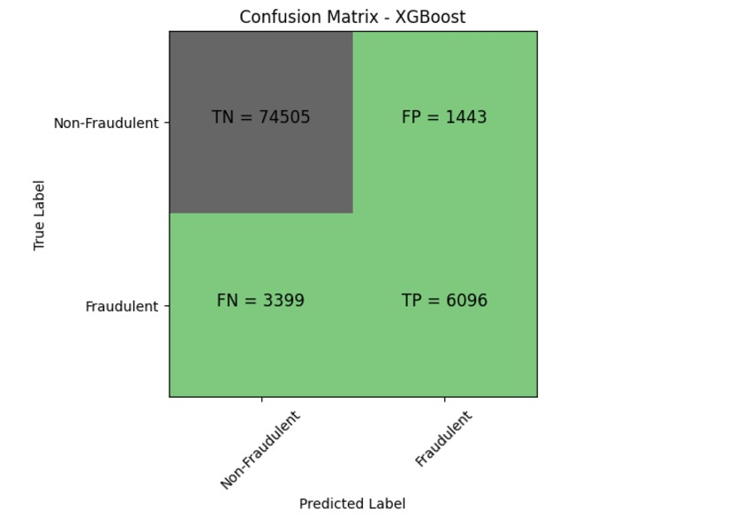
Confusion Matrices
Observations: XGBoost showed best results.

Slide 12
Future Improvements
Explore deep learning models.
Deploy for real-time use.
Fine-tune hyperparameters.

